Slide 1
Data Analytics using
DAX in Power BI

Slide 2
From last lesson…

Slide 3
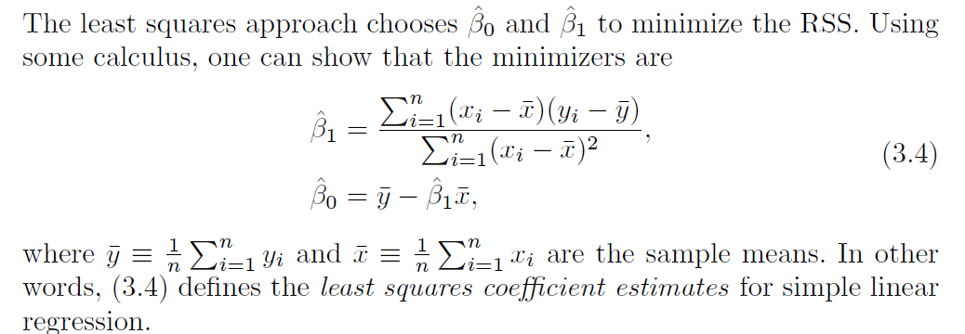
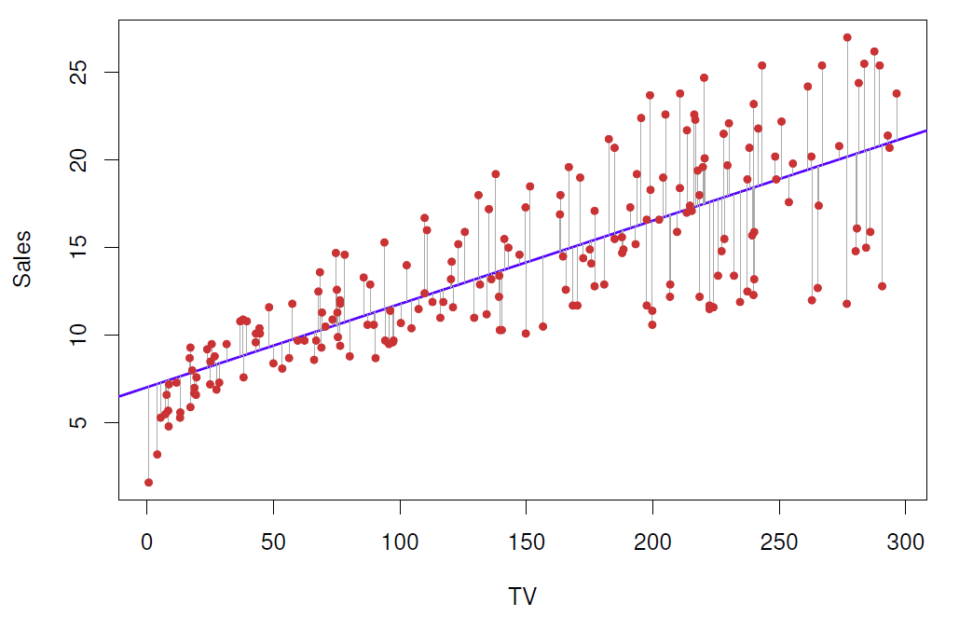
Solution
…or Power BI: Trend Line

Slide 4
Your Power BI journey
Create queries and use the Query Editor to filter, cleanse and reshape data
Configure/refine relationships to establish the foundations of a model
Enrich the model with calculation logic and formatting
Design interactive reports with a broad range of modern data visualizations
Publish solutions directly to the Power BI service
Create queries
Enhance the model
Design reports
Publish to Power BI
Configure relationships

Slide 5
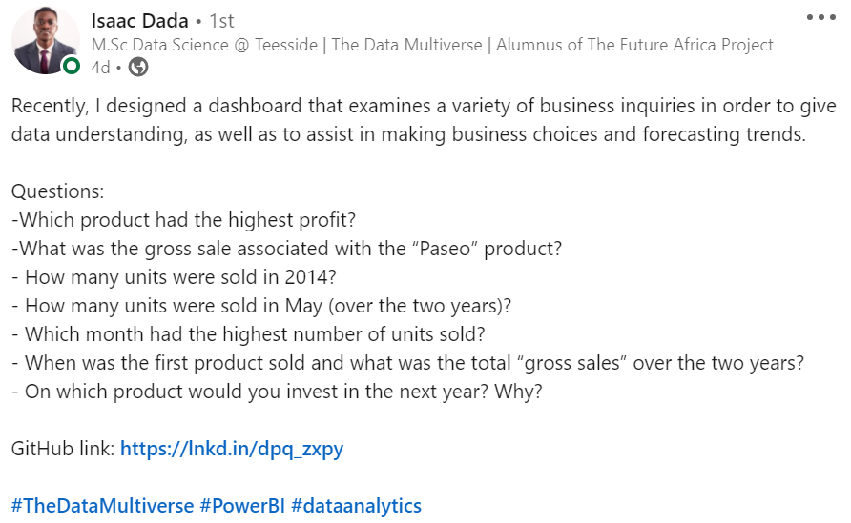
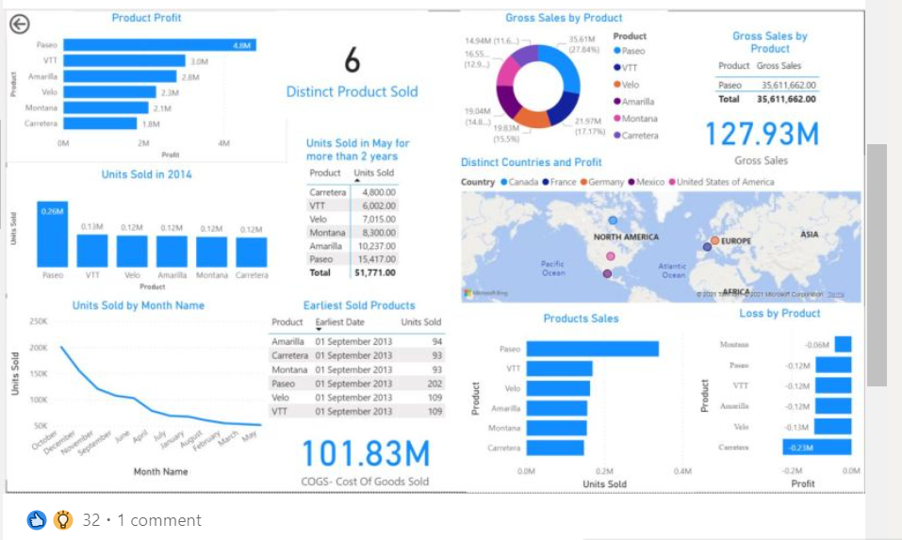
Be proud of your work!

Slide 6

Outline
Data Analysis Expression (DAX) fundamentals.
Implementation of aggregation, counting, and logical functions using DAX - Demo
Notes:
Normalization
Why normalization
https://www.youtube.com/watch?v=xoTyrdT9SZI
How to normalise
https://www.youtube.com/watch?v=mUtAPbb1ECM
https://launchschool.com/books/sql/read/table_relationships#normalization

Slide 7
DAX
DAX stands for Data Analysis Expressions and is the formula language used throughout Power BI (it's also used by Power BI behind the scenes).

Slide 8

Introduction to DAX Language
Link to video: https://www.youtube.com/watch?v=waG_JhBgUpM
Available also on Blackboard

Slide 9
Using DAX - Demo
There are two primary calculations you can create using DAX:
Calculated Columns, to slice or filter on the values
Calculated Measures, to calculate percentages or ratios, or to perform complex aggregations
Before digging into creating either of those, let’s have a look at DAX syntax for tables and columns, which you will use when creating either calculated columns or calculated measures.

Slide 10
Using DAX - Demo
Products and Orders Tables
Create new Calculated Column,
Calculated columns are useful when you want to slice or filter on the value, or if you want a calculation for every row in your table.
New Measure. Use a calculated measure when you are calculating percentages or ratios, or you need complex aggregations.
How to add them both to a report?
Link used in the Demo: https://services.odata.org/V3/Northwind/Northwind.svc/
Notes:
https://docs.microsoft.com/en-us/power-bi/guided-learning/introductiontodax?tutorial-step=2
Link to the data used in the demo https://services.odata.org/V3/Northwind/Northwind.svc/

Slide 11
Using DAX Demo. Aggregation Functions
DAX has a number of aggregation functions, including the following commonly used functions:
SUM – Sum of all the units in stock
AVERAGE – Average number of orders
MIN – minimum unit price
MAX – maximum unit price
These functions work only on numeric columns, and generally can aggregate only one column at a time.

Slide 12
SUM vs SUMX
SUM() | SUMX()
SUM() is an aggregator function. It adds up all the values in a single column you specify after applying all filters that will impact the formula. SUM() has no knowledge of the existence of rows (it can’t do row by row evaluation) – all it can do is add everything in the single column it is presented with after the filters have been applied. | SUMX() is an iterator function. It works through a table, row by row to complete the evaluation after applying all filters. SUMX() has awareness of rows in a table, and hence can reference the intersection of each row with any columns in the table. SUMX() can operate over a single column but can also operate over multiple columns too – because it has the ability to work row by row.

Slide 13
Counting functions as Measures
COUNT – How many values in that column? Orders with Ship Region
COUNTBLANK - How many blank cells in that column? Orders without Ship Region
COUNTROWS – How many orders in total? Order table
DISTINCTCOUNT – How many different Customers? Order table

Slide 14
Logical functions
AND
OR
NOT
IF
IFERROR

Slide 15
And Even more Functions! ☺
Information Functions | Text Functions | Date Functions
ISBLANK | CONCATENATE | DATE
ISNUMBER | REPLACE | HOUR
ISTEXT | UPPER | NOW
ISNONTEXT | FIXED | EOMONTH
ISERROR |  | WEEKDAY

Slide 16
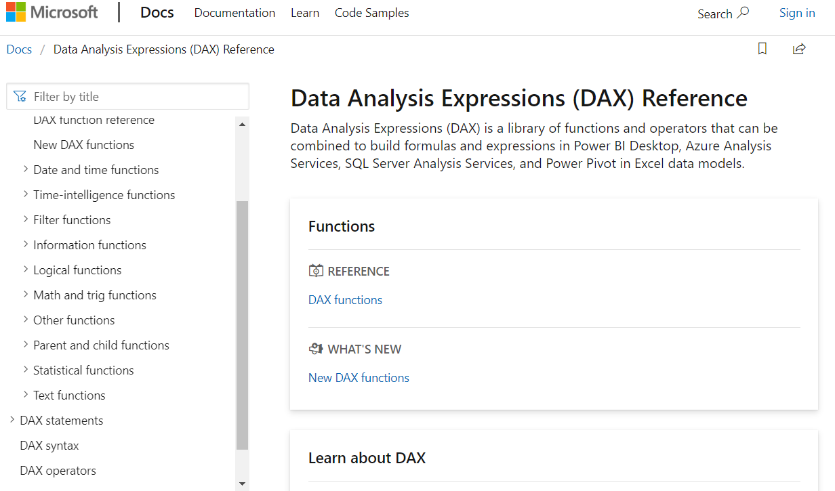
There is plenty more to learn…
https://docs.microsoft.com/en-us/power-bi/desktop-quickstart-learn-dax-basics
https://docs.microsoft.com/en-us/power-bi/guided-learning/introductiontodax
https://docs.microsoft.com/en-us/dax/

Slide 17
Questions?
Feel free to contact me on Teams or email me ☺
c.tarzi@tees.ac.uk

Slide 18
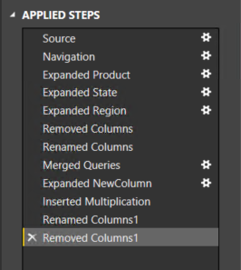
Creating queries
Create queries
Configure relationships
Enhance the model
Design reports
Publish to Power BI
Queries can be edited before loading into the model
Once created, each query:
Is referenced by a unique name
Defines query steps by using the language “M”
Most query step logic does not require writing formulas
Is used to load data into a model table
Notes:
https://powerbi.microsoft.com/en-us/documentation/powerbi-desktop-data-sources/

Slide 19
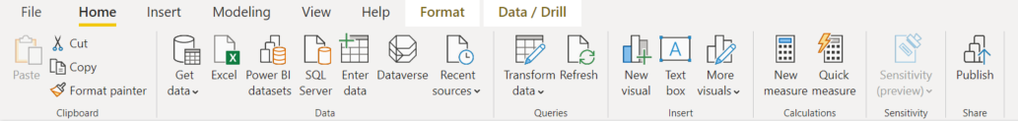
Creating Queries
User experience: Getting data
A query is defined by “getting data”
Source types include Excel, csv, Database, Azure, Online Services and Others
Data can be simply and quickly loaded “as is”
Optionally, the Query Editor can be used to transform queries (Data Analysis)
Notes:
It all begins by connecting to, and retrieving, data.
Power BI knowledgebase: https://support.powerbi.com/knowledgebase/articles/471635-connect-to-data-in-power-bi-designer

Slide 20
Creating queries
Numerous commands are available on the Query Editor ribbons and context menus to:
Manage columns
Reduce rows, including removing errors
Transform
Split
Add columns, by using formulas
As the editor experience is WYSIWYG, users can easily experiment and roll-back changes
What You See Is What You Get

Slide 21
Power BI so far…
Getting data from csv
3 views
Change data-type
Rename columns
Dealing with errors/NAs
Removing columns
Adding a calculated column (Custom column -> = #date([Year], [Month], [Day]))
Splitting a column
Replacing values to improve the readability of the data

Slide 22
Configuring relationships
Create queries
Configure relationships
Enhance the model
Design reports
Publish to Power BI
Relationships enable filters on one table to appropriately propagate filter to other tables
They can be defined between any two tables, regardless of their data connection or source type
However, they must be based on single columns with matching data types

Slide 23
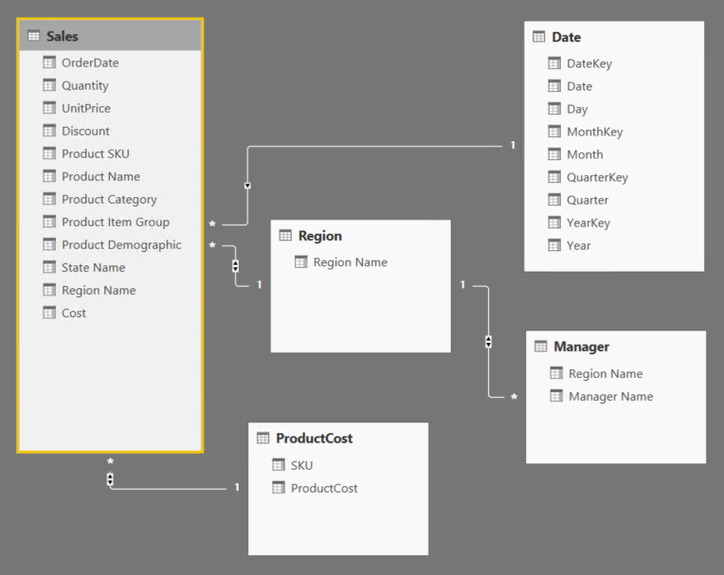
Creating Relationships
User experience: Relationships view
Work in Relationships View to view all tables, columns, measures and relationships in the model
Notes:
Power BI knowledgebase: https://support.powerbi.com/knowledgebase/articles/663229-relationship-view-in-power-bi-desktop

Slide 24
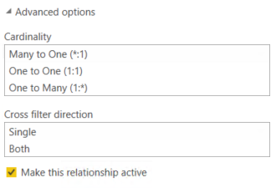
Configuring relationships
Configure relationship advanced options to set:
Cardinality
Cross filter direction
Active/inactive
Tip: All options can be interpreted from symbols used in the relationship diagram

Slide 25
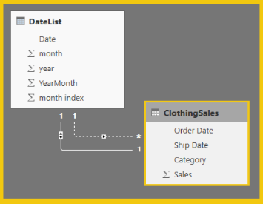
Configuring relationships
It is possible to define multiple relationship paths between two tables
One relationship must be active, and will be used by default during model browsing
The remaining relationships are inactive, and can be used explicitly in model calculations

Slide 26
Enhancing the model
Perform data analytics using
Power Query M formula
DAX

Slide 27
Questions?
Feel free to contact me on Teams or email me ☺
a.occhipinti@tees.ac.uk

Slide 28
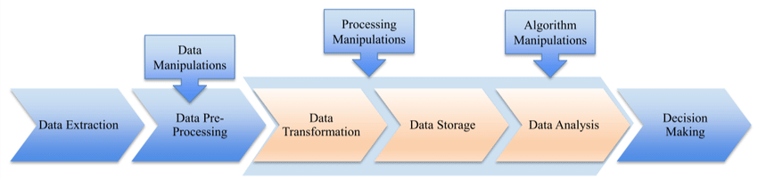
Summary: Your Data Analytics Journey
Data Extraction
What data is most relevant to the business objective
What data should you collect to answer a given business question
Prepare the Data (pre-processing)
Eliminate duplicate data
Data is properly formatted so that the analytics software can work with it

Slide 29

Summary: Your Data Analytics Journey
3. Start the Data Analytics process
Build a predictive model using statistical algorithms on small samples
Test your model on a partial set of samples to test the accuracy
Using the accuracy result, adjust the algorithm and run the mode again to increase accuracy.
Once your algorithm has reached a desired accuracy, the predictive model runs on a full data set to answer the business question.
4. Share the results
Finally, you decide how to share the results with others.
Communicate your information simply and clearly

Slide 30
A few Points to consider about your ICA
Dr Annalisa Occhipinti
a.occhipinti@tees.ac.uk

Slide 31
Assessment - ICA
In course Assessment (ICA)
The assessment will be in the form of an in-course assignment (ICA) that requires students to design and implement a Data Warehouse/Business Intelligence solution using an appropriate dataset.
Along with the solution, students will prepare a technical report (approx. 1,200 words) that will include a summary of the solution (design and implementation), an evaluation of the solution and personal reflection.

Slide 32
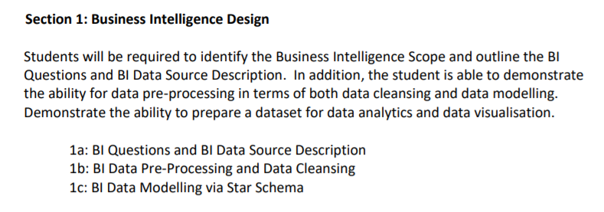
Section 1

Slide 33
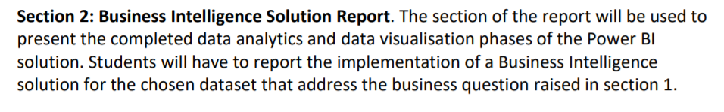
Section 2

Slide 34
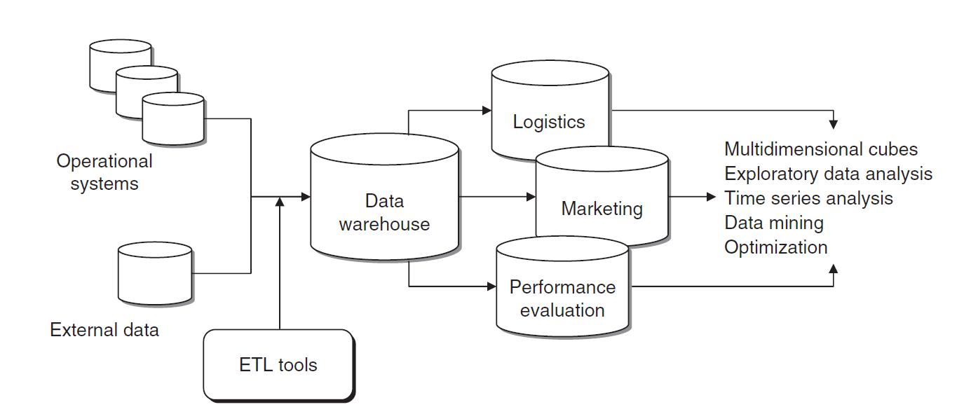
A typical BI architecture
Notes:
Normalization
Why normalization
https://www.youtube.com/watch?v=xoTyrdT9SZI
How to normalise
https://www.youtube.com/watch?v=mUtAPbb1ECM
https://launchschool.com/books/sql/read/table_relationships#normalization

Slide 35
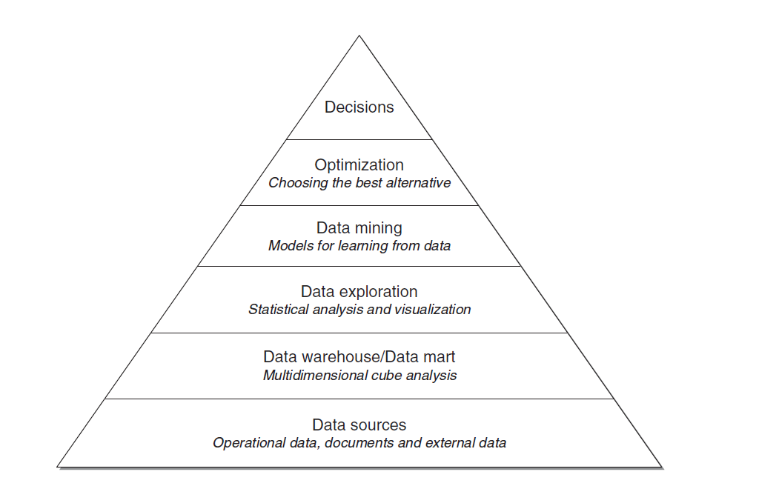
Step 1: Planning your BI journey

Slide 36
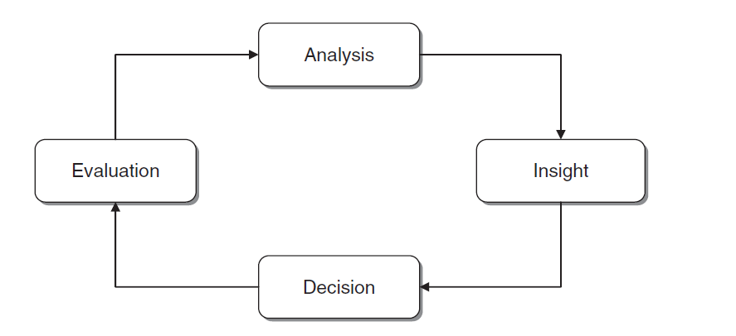
Step 2: BI cycle

Slide 37
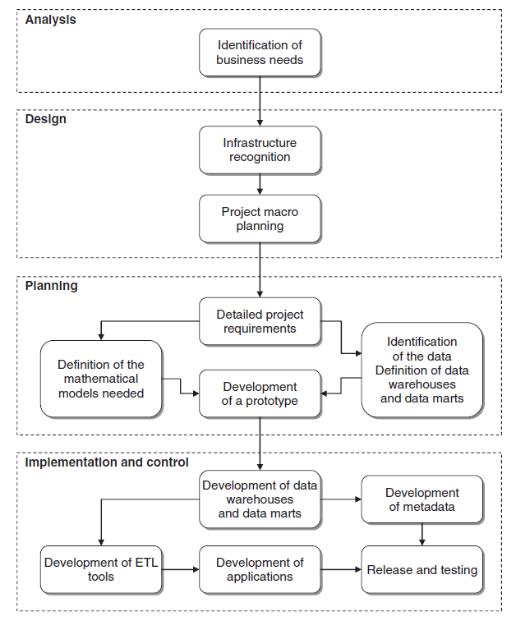
The whole picture

Slide 38
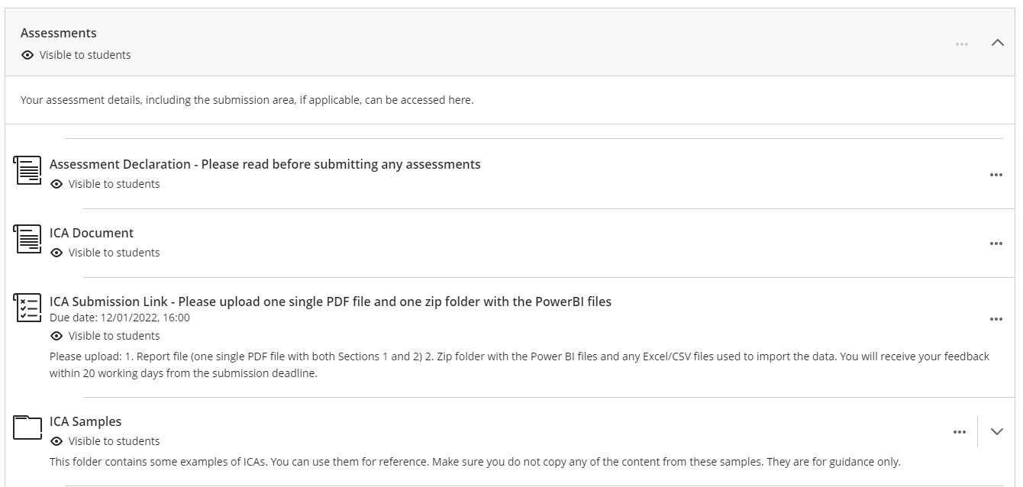
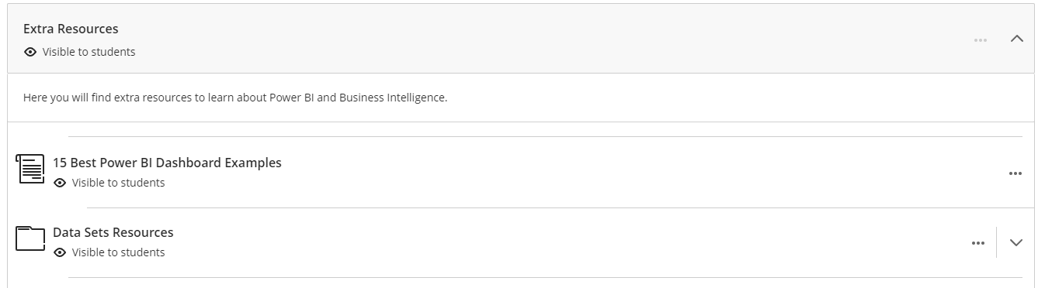
For more details check the ICA document, under Assessment on Blackboard and the Extra Resources folder for public data repositories Check also the ICA Samples for more ideas

